Slide 1

Session 2: scRNA-seq Overview

Slide 2
Session 2: scRNA-seq Overview
Outline
Sample Preparation
Cluster Generation
Sequencing
Cell Ranger
Downstream Analysis
Limitations

Slide 3
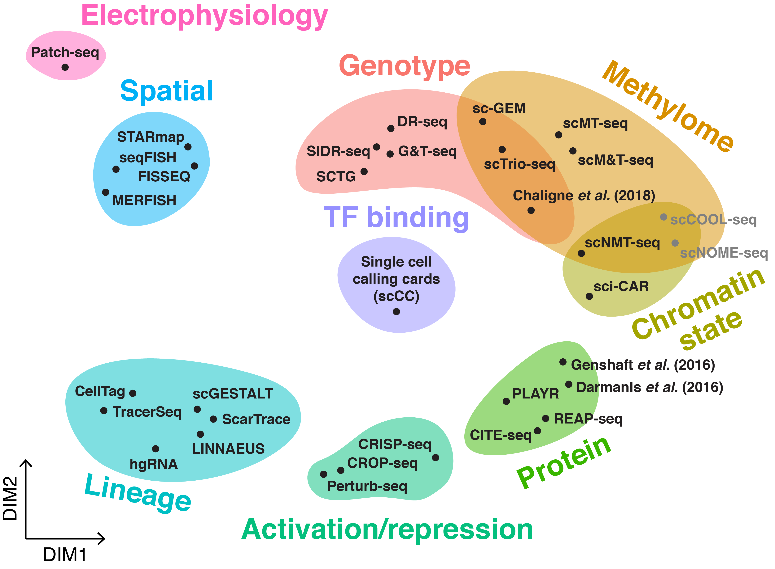
Session 2: scRNA-seq Overview
Notes:
The range of multimodal scRNA-seq technologies.

Slide 4
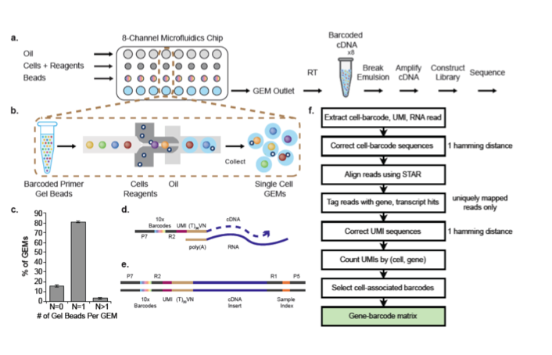
Session 2: scRNA-seq Overview
Notes:
Basic droplet-based protocol from 10x Chromium.

Slide 5
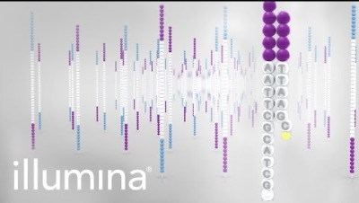
Session 2: scRNA-seq Overview
Notes:
https://www.youtube.com/watch?v=fCd6B5HRaZ8

Slide 6
Session 2: scRNA-seq Overview
Outline
Sample Preparation
Cluster Generation
Sequencing
Cell Ranger
Downstream Analysis
Limitations

Slide 7
Session 2: scRNA-seq Overview
Outline
Sample Preparation
Cluster Generation
Sequencing
Cell Ranger
Downstream Analysis
Limitations

Slide 8
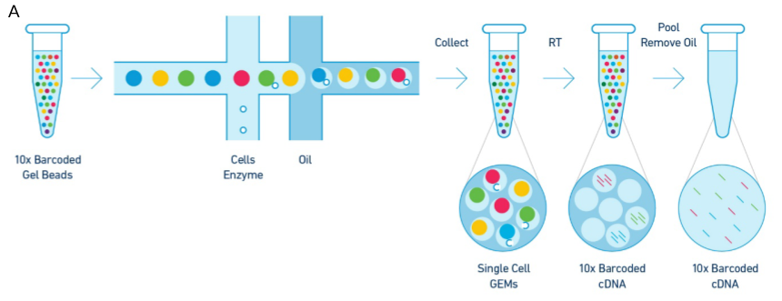
Sample Preparation

Slide 9
Sample Preparation
Get nucleic acids from cell type of interest!
Notes:
Involves gathering nucleic acids from your organism and cell types of interest. Usually involves isolating and purifying nucleic acids, shearing nucleic acids to certain sizes, amplifying the product, and ligating sequencing adaptors (small fragments of DNA used to anchor a molecule of interest onto the flow cell).

Slide 10
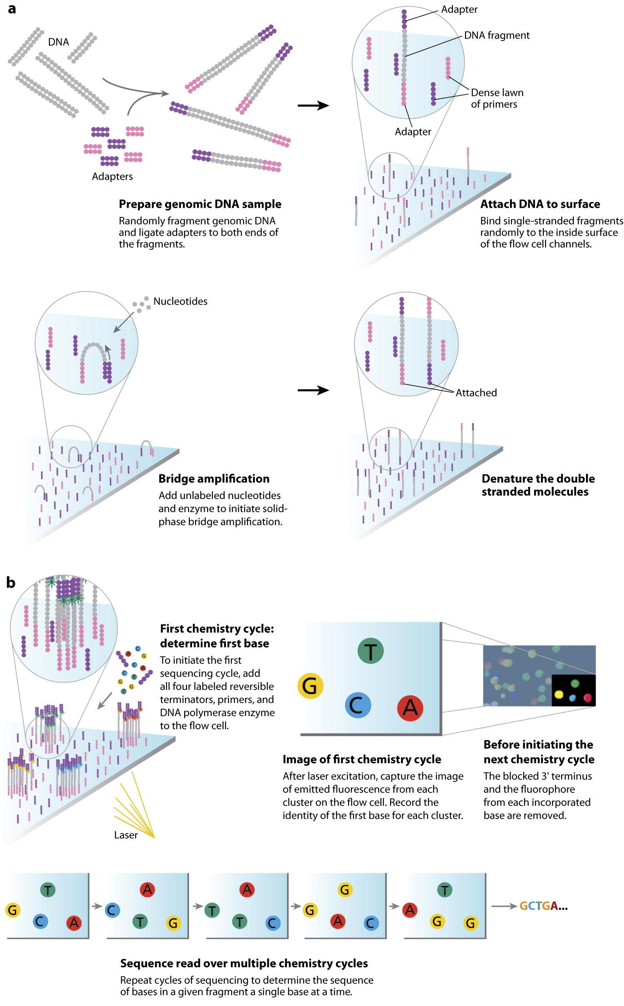
Sample Preparation

Slide 11
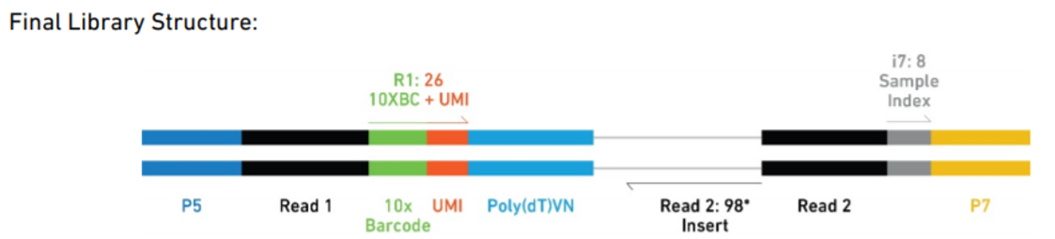
Sample Preparation
Notes:
End result is a library (a pool of DNA fragments with adapters attached).

Slide 12
Sample Preparation
Adapters
Notes:
End result is a library (a pool of DNA fragments with adapters attached).

Slide 13
Session 2: scRNA-seq Overview
Outline
Sample Preparation
Cluster Generation
Sequencing
Cell Ranger
Downstream Analysis
Limitations

Slide 14
Session 2: scRNA-seq Overview
Outline
Sample Preparation
Cluster Generation
Sequencing
Cell Ranger
Downstream Analysis
Limitations

Slide 15
Cluster Generation
Turn libraries into clonal clusters on a flow cell!
Notes:
Flow cell = thick glass slide with channels/lanes; each lane is randomly coated with a lawn of oligos that are complementary to library

Slide 16
Cluster Generation
Turn libraries into clonal clusters on a flow cell!

Slide 17
Cluster Generation
Turn libraries into clonal clusters on a flow cell!

Slide 18
Cluster Generation
Turn libraries into clonal clusters on a flow cell!
Notes:
Clusters represent thousands of copies of the same DNA strand in a 1-2 micron spot.

Slide 19
Session 2: scRNA-seq Overview
Outline
Sample Preparation
Cluster Generation
Sequencing
Cell Ranger
Downstream Analysis
Limitations

Slide 20
Session 2: scRNA-seq Overview
Outline
Sample Preparation
Cluster Generation
Sequencing
Cell Ranger
Downstream Analysis
Limitations

Slide 21
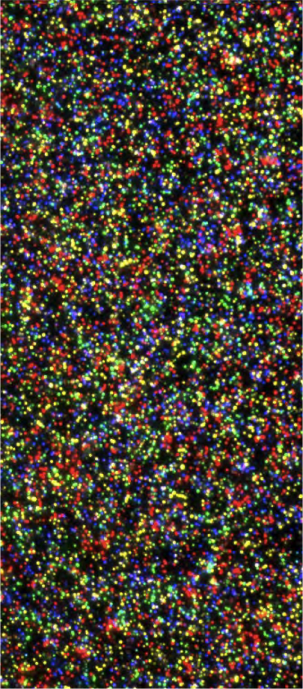
Sequencing
Notes:
Sequencing by synthesis (each of the four DNA bases emit an intensity of a unique wavelength).

Slide 22
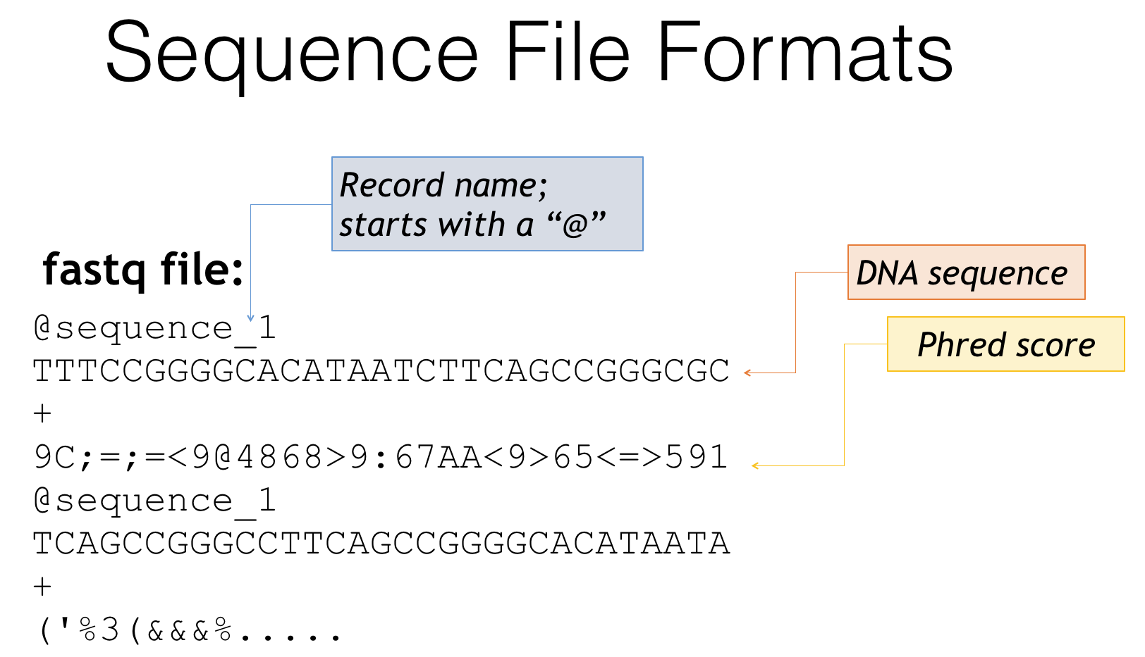
Sequencing

Slide 23
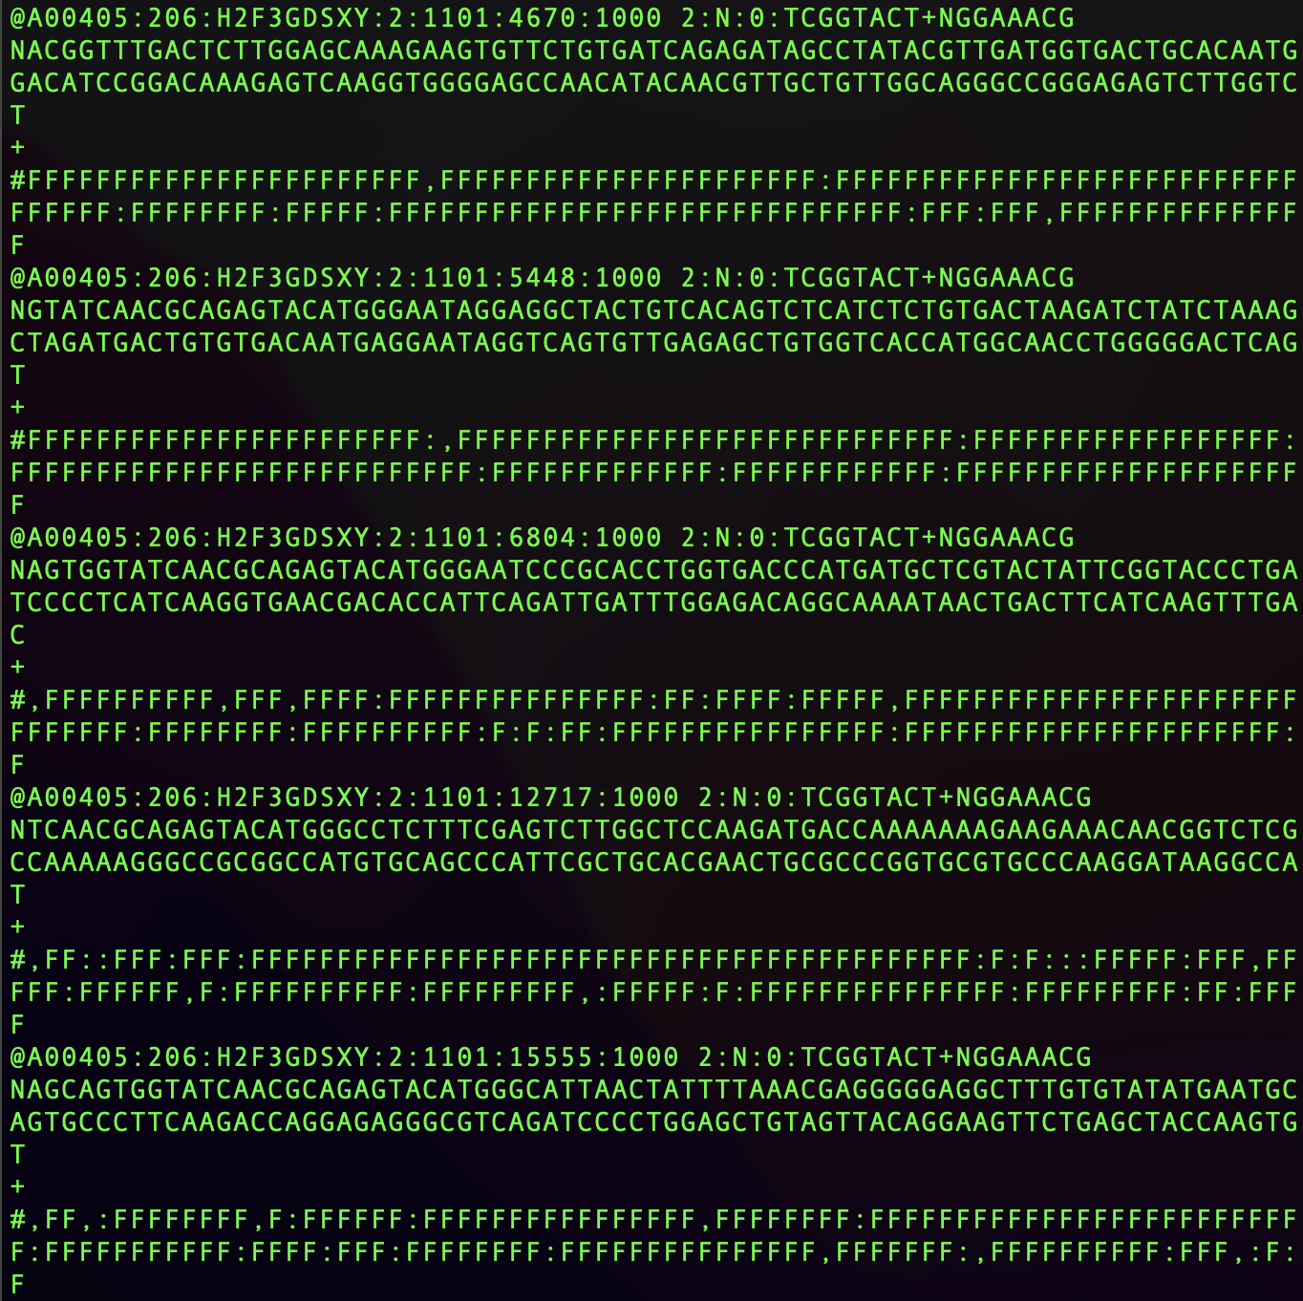
Sequencing

Slide 24
Session 2: scRNA-seq Overview
Outline
Sample Preparation
Cluster Generation
Sequencing
Cell Ranger
Downstream Analysis
Limitations

Slide 25
Session 2: scRNA-seq Overview
Outline
Sample Preparation
Cluster Generation
Sequencing
Cell Ranger
Downstream Analysis
Limitations

Slide 26
Cell Ranger

Slide 27
Cell Ranger

Slide 28
Cell Ranger
Cell Ranger is actually a set of different pipelines.
cellranger mkfastq – demultiplexes and converts raw base call (BCL) files for each flow cell directory into fastq files
cellranger count – quantifies single-cell gene expression (alignment, filtering, barcode counting, and UMI counting)
cellranger aggr – aggregates output from multiple runs of cellranger count and normalizes them
cellranger reanalyze – reanalyzes feature-barcode matrices produced by cellranger count
cellranger multi – analyzes Cell Multiplexing data

Slide 29
Cell Ranger
Cell Ranger is actually a set of different pipelines.
cellranger mkfastq – demultiplexes and converts raw base call (BCL) files for each flow cell directory into fastq files
cellranger count – quantifies single-cell gene expression (alignment, filtering, barcode counting, and UMI counting)
cellranger aggr – aggregates output from multiple runs of cellranger count and normalizes them
cellranger reanalyze – reanalyzes feature-barcode matrices produced by cellranger count
cellranger multi – analyzes Cell Multiplexing data

Slide 30
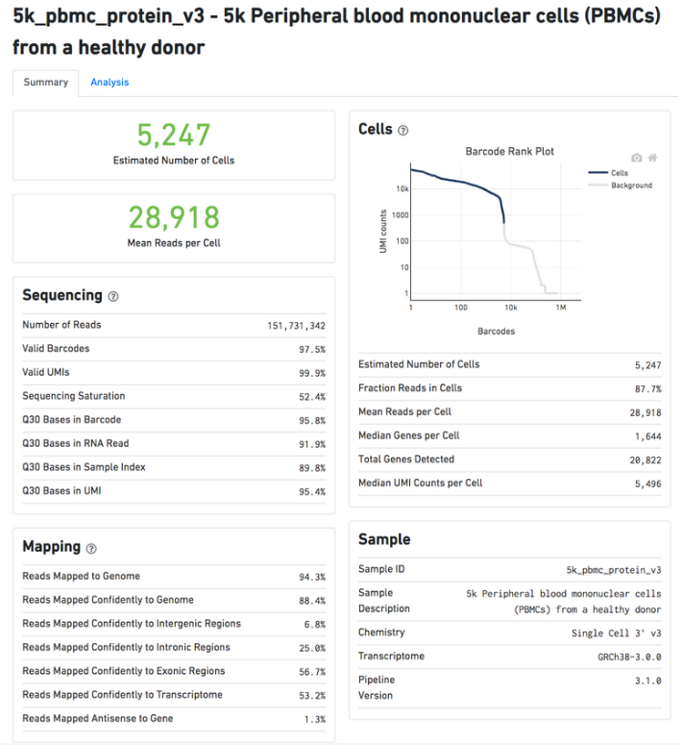
Cell Ranger
Cell Ranger output: web summary, filtered_feature_bc_matrix

Slide 31
Cell Ranger
Cell Ranger output: web summary, filtered_feature_bc_matrix
# of cells close to expectations?

Slide 32
Cell Ranger
Cell Ranger output: web summary, filtered_feature_bc_matrix
# of cells close to expectations?
Mean reads per cell?

Slide 33
Cell Ranger
Cell Ranger output: web summary, filtered_feature_bc_matrix
# of cells close to expectations?
Mean reads per cell?
Median genes per cell?

Slide 34
Cell Ranger
Cell Ranger output: web summary, filtered_feature_bc_matrix
# of cells close to expectations?
Mean reads per cell?
Median genes per cell?
Sequencing saturation?
Notes:
Sequencing saturation = measure of the fraction of library complexity that was captured during sequencing. Inverse of sequencing saturation can be interpreted as roughly the number of new transcripts you expect to find with one new read. If sequencing saturation is at 50%, every 2 new reads will result in 1 new UMI count (unique transcript) detected. 90% sequencing saturation means that 10 new reads are necessary to obtain one new UMI count.

Slide 35
Cell Ranger
Cell Ranger output: web summary, filtered_feature_bc_matrix
# of cells close to expectations?
Mean reads per cell?
Elbow plot?
Median genes per cell?
Sequencing saturation?

Slide 36
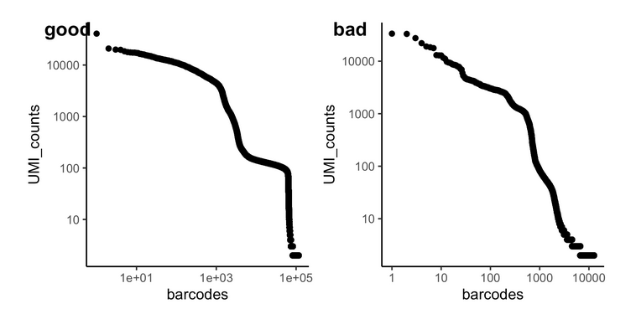
Cell Ranger
Cell Ranger output: web summary, filtered_feature_bc_matrix
# of cells close to expectations?
Mean reads per cell?
Elbow plot?
Median genes per cell?
Sequencing saturation?

Slide 37
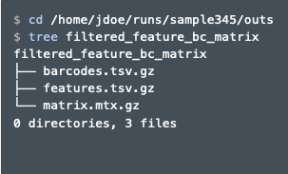
Cell Ranger
Cell Ranger output: web summary, filtered_feature_bc_matrix

Slide 38
Cell Ranger
Cell Ranger output: web summary, filtered_feature_bc_matrix
feature-barcode matrix; each element of the matrix is the number of UMIs associated with a feature (row) and a barcode (column). Stored as sparse matrix.

Slide 39
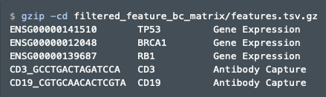
Cell Ranger
Cell Ranger output: web summary, filtered_feature_bc_matrix
Features (often genes) correspond to row indices. For each feature, its feature ID and name are stored in the first and second column of the file. The third column identifies the type of feature (often Gene Expression).

Slide 40
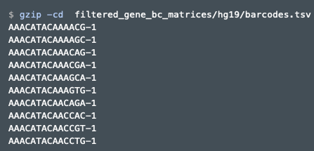
Cell Ranger
Cell Ranger output: web summary, filtered_feature_bc_matrix
Barcode sequences correspond to column indices.

Slide 41
Session 2: scRNA-seq Overview
Outline
Sample Preparation
Cluster Generation
Sequencing
Cell Ranger
Downstream Analysis
Limitations

Slide 42
Session 2: scRNA-seq Overview
Outline
Sample Preparation
Cluster Generation
Sequencing
Cell Ranger
Downstream Analysis
Limitations

Slide 43
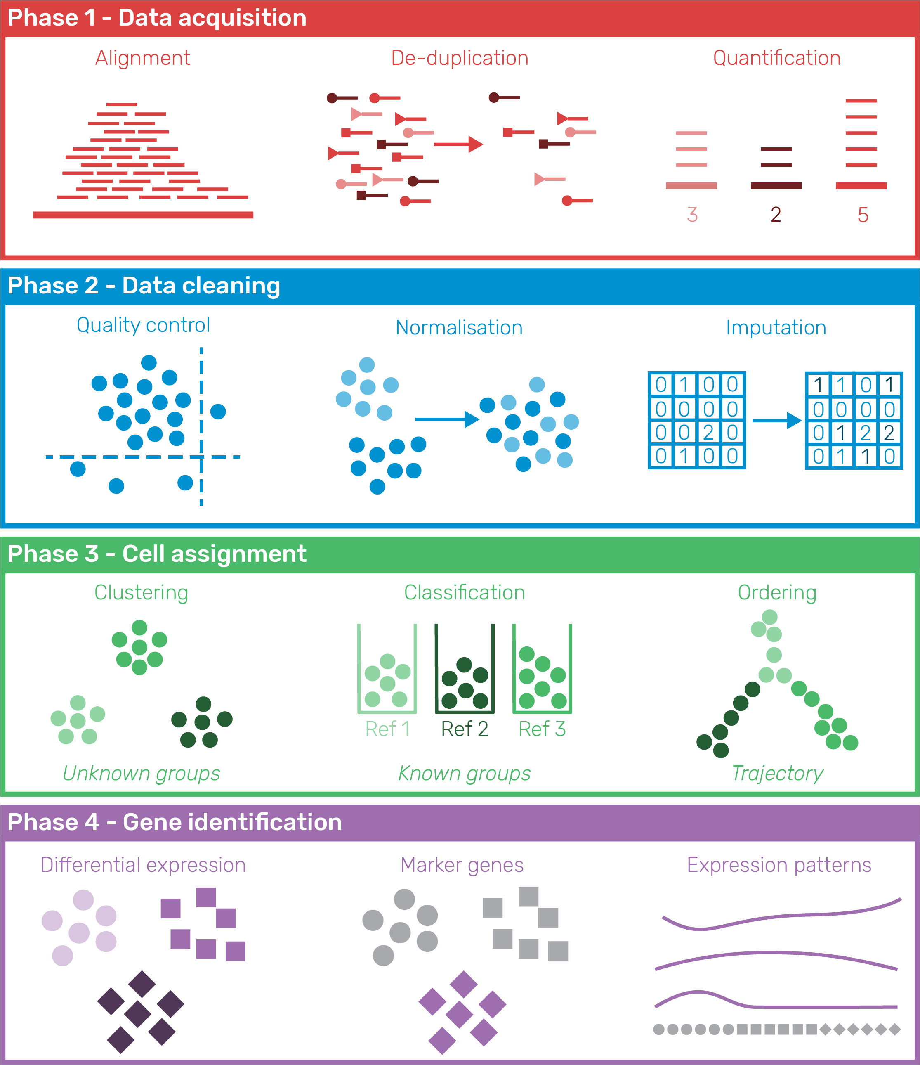
Downstream Analysis

Slide 44
Downstream Analysis
Done by Cell Ranger!

Slide 45
Downstream Analysis

Slide 46
Downstream Analysis
Seurat, Scanpy

Slide 47
Downstream Analysis
Seurat, Scanpy

Slide 48
Session 2: scRNA-seq Overview
Outline
Sample Preparation
Cluster Generation
Sequencing
Cell Ranger
Downstream Analysis
Limitations

Slide 49
Session 2: scRNA-seq Overview
Outline
Sample Preparation
Cluster Generation
Sequencing
Cell Ranger
Downstream Analysis
Limitations

Slide 50
Limitations
scRNA-seq is very cool and useful, but it’s not perfect.
dropout effect – only a small portion of the mRNAs from each cell is captured
low # of detectable genes – might not detect low expressing genes at all
provides little info outside of gene counts
discrepancies between RNA and protein (especially surface proteins)
constantly evolving chemistry and bioinformatics tools

Slide 51
Let’s explore bodhi!

